Slide 1

COIS 3320: Fundamentals of Operating Systems
Alaadin Addas
Week 8
Memory Management

Slide 2
Overview
Announcements/Reminders
Recap
Memory Management
Requirements for Efficient Memory Management
Managing Insufficient Memory
Paging
Segmentation & Paging
Summary
Report
Lab 3

Slide 3
Announcements/Reminders
Assignment 2 is due by tonight (12th of March).
Remember you have until the 14th of March by 11:59PM to submit it with no late penalty.
We will discuss the details of the report today.
The course drop deadline is on the 15th of March.
You already have 35% of your grade (A1 – 10%, Midterm – 15%, 2 Labs – 10%)
You have enough of your grade to determine how you are doing in the course.

Slide 4
Recap
In our previous lecture (Week 6), we talked about deadlock detection, avoidance, and prevention.
What is the simplest explanation of a deadlock?
Is the Banker’s Algorithm a deadlock avoidance algorithm or a deadlock prevention algorithm?

Slide 5
Physical Memory
A computer's physical memory (RAM) is a hardware structure consisting of a linear sequence of words that hold a program during execution.
A word is a fixed-size unit of data. A typical word size is 4 bytes but can also be a single byte.
A physical address is an integer in the range [0 : n-1] that identifies a word in physical memory of size n.
The address comprises a fixed number of bits.
A memory of size n requires an address size of k bits, where n = 2 ^ k

Slide 6
Logical Memory
During program development, the starting address of a program in physical memory is unknown.
To facilitate program development and the sharing of physical memory, the concept of a logical address space is employed.
A logical address space is an abstraction of physical memory, consisting of a sequence of imaginary memory locations in a range [0 : m-1], where m is the size of the logical address space.
A logical address is an integer in the range [0 : m-1] that identifies a word in a logical address space.
Prior to execution, a logical address space is mapped to a portion of physical memory and the program is copied into the corresponding locations.

Slide 7
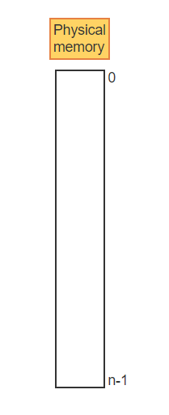
Logical V.S Physical Memory – Visualization -1
A computer system has a single physical memory consisting of n words addressed by fixed-size physical addresses in the range [0 : n-1]

Slide 8
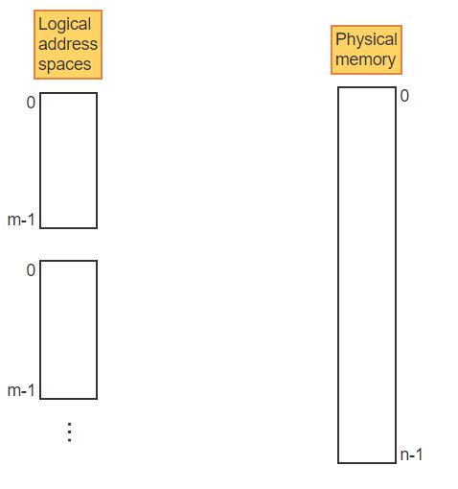
Logical V.S Physical Memory – Visualization -2
To facilitate program development and program loading, multiple logical address spaces are provided with possibly different address ranges [0 : m-1]

Slide 9
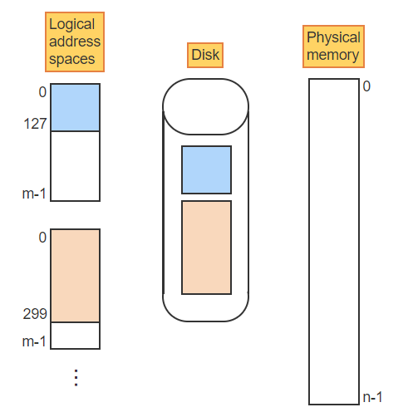
Logical V.S Physical Memory – Visualization -3
The occupied portion of each logical address space is kept on disk

Slide 10
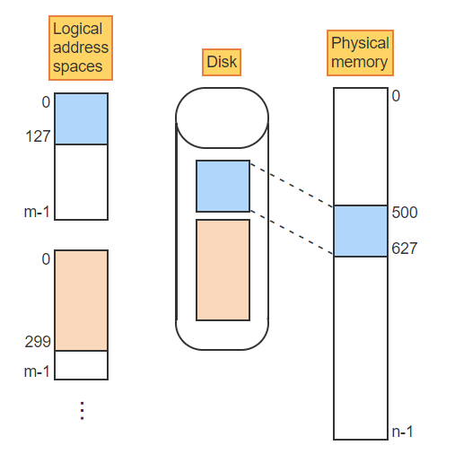
Logical V.S Physical Memory – Visualization -4
A program may be copied to a contiguous region of physical memory when needed for execution. Logical space [0 : 127] is copied to memory locations [500 : 627]

Slide 11
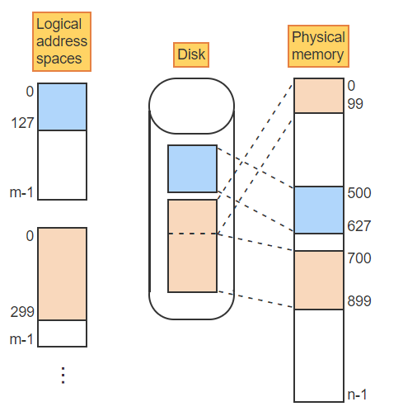
Logical V.S Physical Memory – Visualization -5
A program can also be copied to multiple disjoint regions of physical memory. The space [0 : 299] is mapped to the regions [0 : 99] and [700 : 899]

Slide 12
Program Transformations
A source module is a program or a program component written in a symbolic language, like C, or an assembly language, that must be translated by a compiler or assembler into executable machine code.
An object module is the machine-language output of a compiler or assembler generated from a source module.
An object module may be self-contained and executable or multiple object modules may be linked together into a load module by a linker or linkage editor.
A load module is a program or combination of programs in a form ready to be loaded into main memory and executed.

Slide 13
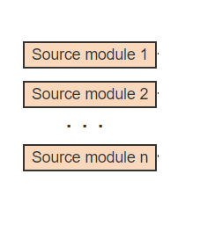
Program Transformations – Visualization – 1
A program consists of one or more source modules written in a high-level language or assembly language. Type yes in the chat if you would like to program in MIPS again.

Slide 14
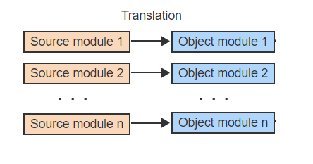
Program Transformations – Visualization – 2
Each module is translated separately into an object module using a compiler or assembler

Slide 15
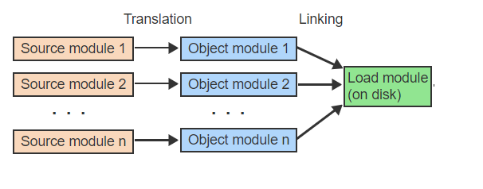
Program Transformations – Visualization – 3
Object modules are combined into a load module by a linker. The load module is kept on disk

Slide 16
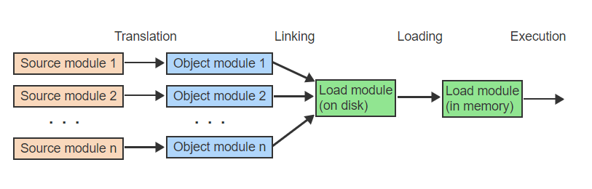
Program Transformations – Visualization – 4
Prior to execution, the load module is copied to physical memory by a loader

Slide 17
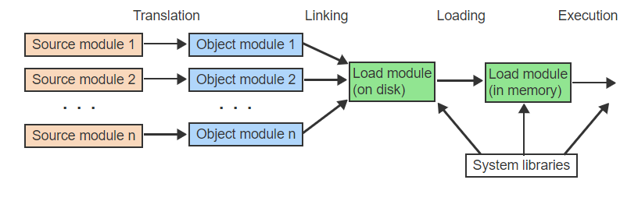
Program Transformations – Visualization – 5
Various system libraries, in the form of object modules, may be included in the load module by the linker, the loader, or during execution

Slide 18
Relocation & Address Binding
Since the physical addresses of the program components are not known until load time, the compiler/assembler and the linker assume logical address spaces starting with address 0.
During each step of the program transformation, the logical addresses of instructions and data may be changing.
Only during the final step of program loading are all logical address bound to actual physical address in memory.
Program relocation is the act of moving a program component from one address space to another.
The relocation may be between two logical address spaces or from a logical address space to a physical address space.

Slide 19
Relocation & Address Binding
Static relocation binds all logical addresses to physical addresses prior to execution.
Dynamic relocation postpones the binding of a logical address to a physical address until the addressed item is accessed during execution.

Slide 20
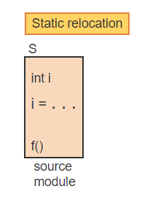
Static V.S. Dynamic Relocation – Visualization -1
A program consists of multiple source modules, each written in a high-level language. Module S defines a variable i, which is later assigned a value. Function f resides in a different module

Slide 21
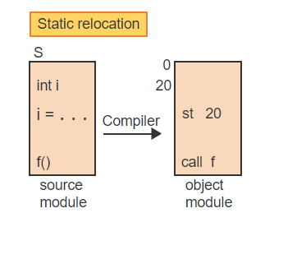
Static V.S. Dynamic Relocation – Visualization -2
The compiler assumes a logical address 0 and assigns i to address 20. The store instruction st then references location 20. The location of f is unknown and is kept as a symbolic external reference

Slide 22
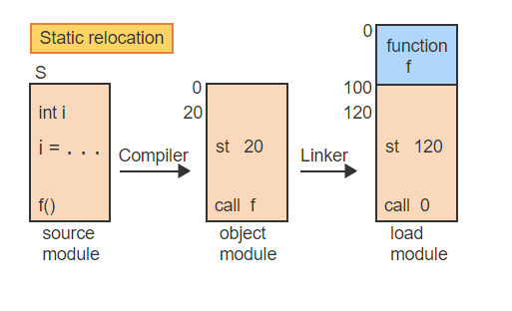
Static V.S. Dynamic Relocation – Visualization -3
The linker also assumes a logical starting address of 0 and combines all object modules into one load module. S is relocated to reflect the starting address 100. The call now refers to the start of f

Slide 23
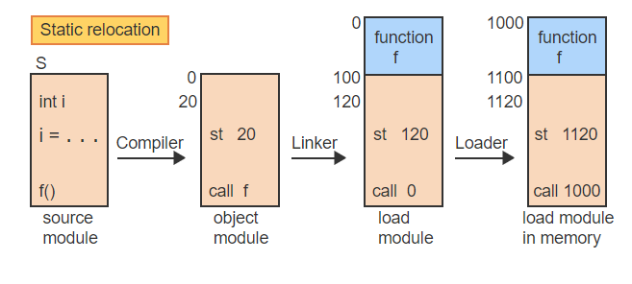
Static V.S. Dynamic Relocation – Visualization - 4
With static relocation, the loader must adjust all logical addresses to physical addresses when copying the module into memory at the starting physical address of 1000

Slide 24
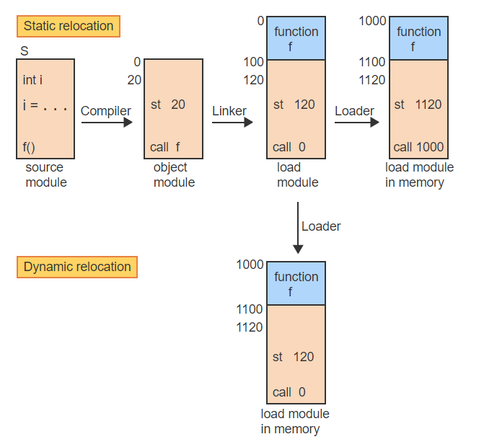
Static V.S. Dynamic Relocation – Visualization - 5
With dynamic relocation, the load module is copied into memory also starting at address 1000 but without any changes to the addresses in the code

Slide 25
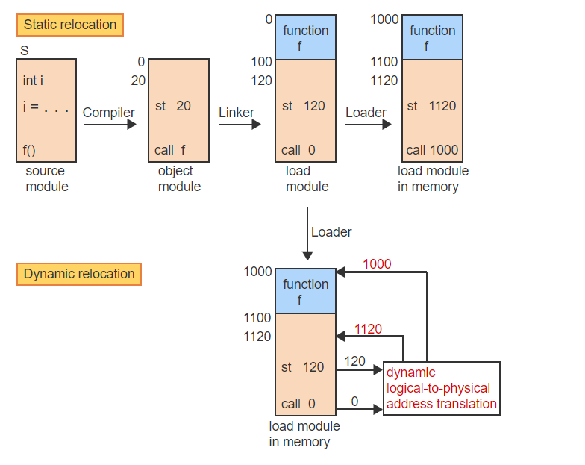
Static V.S. Dynamic Relocation – Visualization - 6
Relocation is done at runtime by adding the starting address 1000 to every address when referenced

Slide 26
Relocation Registers
A relocation register is a special register that contains the physical starting address of a program or program component in memory.
Most programs consist of 3 main components: code, static data, and dynamic data.
A simple memory management scheme treats the 3 components as one unit, which must be moved into one contiguous area of memory.
Dynamic relocation can be implemented using a single relocation register, which is loaded with the program's starting address.
The register content is then added automatically by the CPU to every logical address of the program to generate the physical address.

Slide 27
Free Space Management
As programs are moved into and out of memory at runtime, the memory space becomes a checkerboard of free and occupied areas of different sizes.
The OS keeps track of all free spaces, referred to as holes, using a linked list and must find a hole of appropriate size whenever a new program component is to be loaded into memory.
The OS must also coalesce any neighboring holes resulting from the removal of programs from memory to prevent the memory from becoming a fragmented collection of increasingly smaller holes.

Slide 28
Free Space Management
Different search strategies have been explored:
First-fit always starts the search from the beginning of the list and allocates the first hole large enough to accommodate the request.
Next-fit starts each search at the point of the last allocation.
Best-fit searches the entire list and chooses the smallest hole large enough to accommodate the request.
Worst-fit takes the opposite approach from best-fit by always choosing the largest available hole for any request.
Which one is best?
It depends.
The choice depends on the average request size relative to the memory size, and the variance of request sizes.

Slide 29
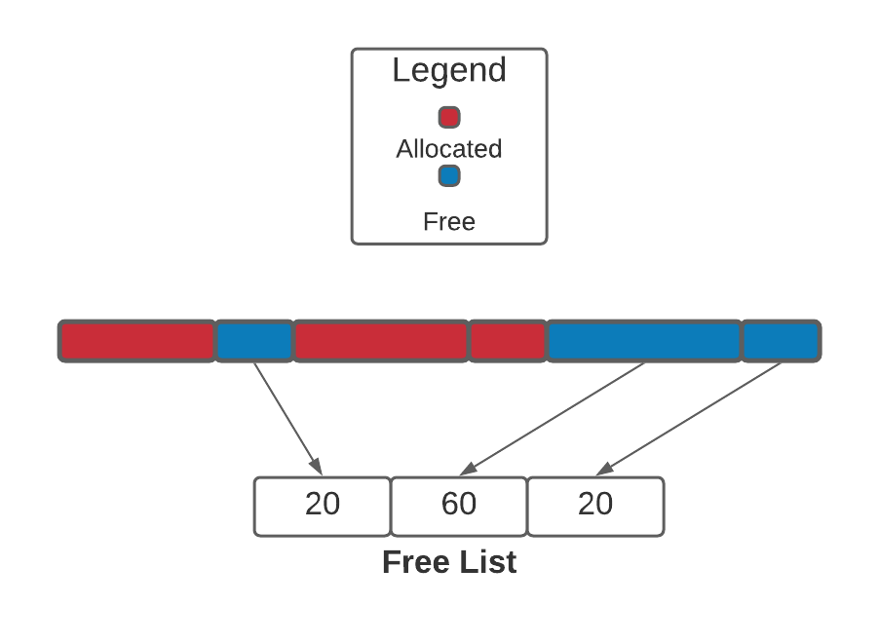
First Fit
If a program requests a block of size 30, where would it go according to this memory visualization using the first fit algorithm?

Slide 30
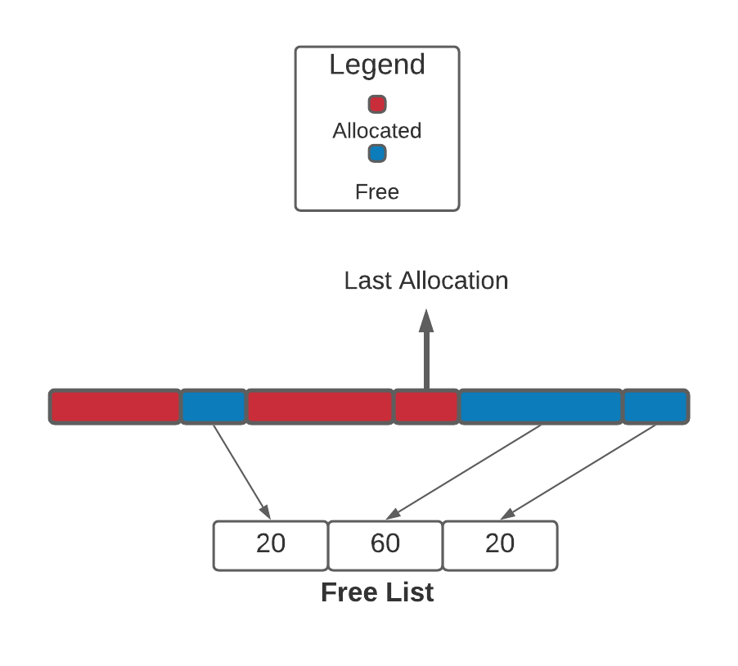
Next Fit
If a program requests a block of size 10, where would it go according to this memory visualization using the next fit algorithm?

Slide 31
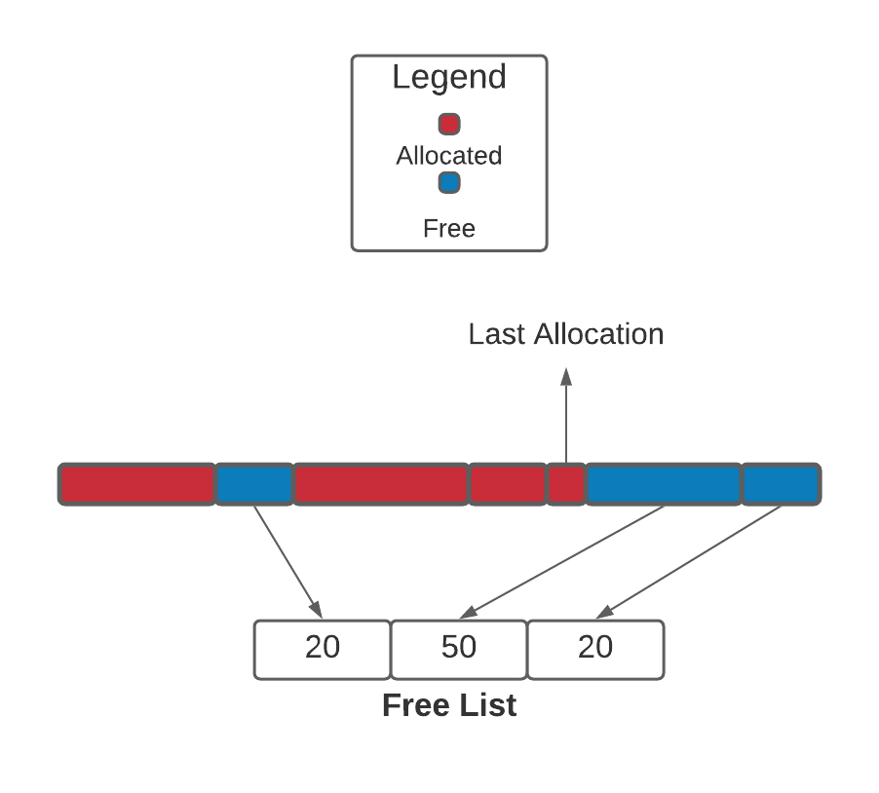
Next Fit
The same program now requests a block of size 20, where would it go according to this memory visualization using the next fit algorithm?

Slide 32
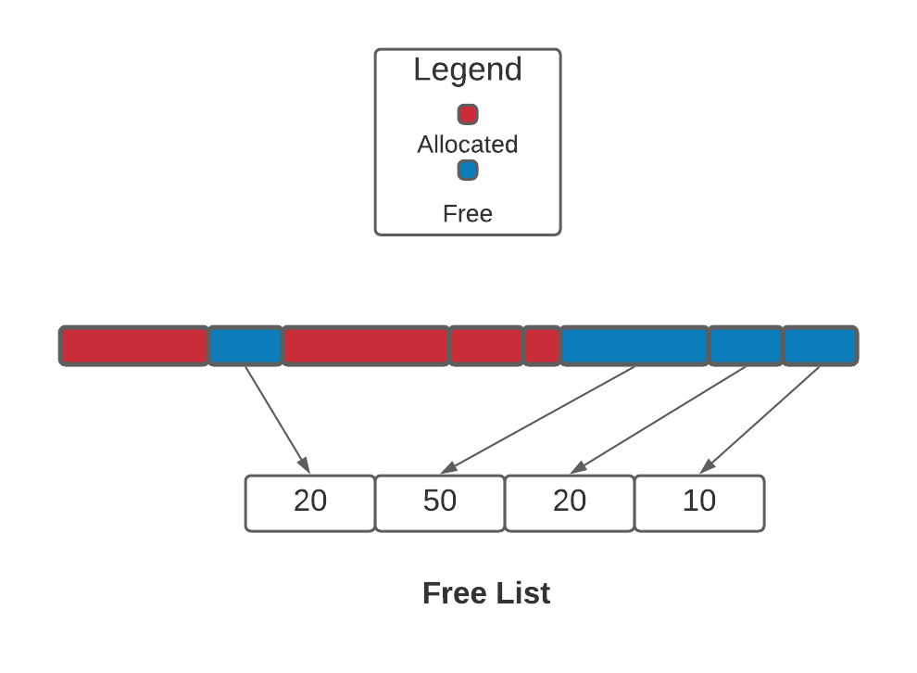
Best Fit
A program requests a block size of 10 where would it go according to this memory visualization under the best fit algorithm?

Slide 33

Worst Fit
A program requests a block size of 20 where would it go according to this memory visualization under the worst fit algorithm?
Why does worst fit even exit?

Slide 34
Managing Insufficient Memory
While memory size has been increasing, so has demand for the memory!
External memory fragmentation is the loss of usable memory space due to holes between allocated blocks of variable sizes.
The 50% rule states that, if the probability of finding an exact match for a request approaches 0, one third of all memory partitions are holes and two thirds are occupied blocks.
Formally, n = 0.5 m, where n is the number of holes and m is the number of occupied blocks.

Slide 35
Swapping & Memory Compaction
When no hole large enough for a request is available, the process can either be delayed until more memory is released or two possible actions may be taken to create more space:
Swapping is the temporary removal of a module from memory. The module is saved on a disk and later moved back to memory. Dynamic relocation is necessary so that the module can be placed into a different location without modification. OR
Memory compaction is the systematic shifting of modules in memory, generally in one direction, to consolidate multiple disjoint holes into one larger hole.

Slide 36
Dynamic Linking
Linking is the act of resolving external references among object modules and can be done statically, before loading, or dynamically, while the program is already executing.
A program typically comprises many modules, not all of which are needed during every run.
Most programs also link to systems libraries, many of which are rarely invoked.
When modules are linked statically, they all must be in memory during execution.
Dynamic linking improves memory utilization by postponing the linking and loading of any module until the module is actually needed during execution.
Think of DLLs!

Slide 37
Dynamic Sharing
Sharing is the act of linking the same copy of a module to multiple other modules.
Sharing improves memory utilization by allowing multiple processes to share common routines or services (Ex: compilers, editors, word processors), or common data (Ex: dictionaries).
Sharing is possible under both static and dynamic linking.

Slide 38
Paging
A page is a fixed-size contiguous block of a logical address space identified by a single number, the page number.
A page frame is a fixed-size contiguous block of physical memory identified by a single number, the page frame number.
A page table is an array that keeps track of which pages of a given logical address space reside in which page frames.
Each page table entry corresponds to one page and contains the starting address of the frame containing the page.

Slide 39
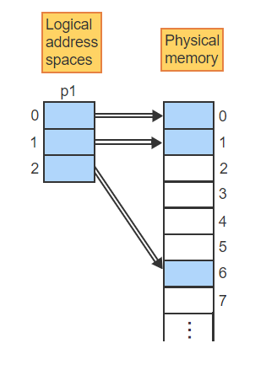
Paging – Visualized – 1
Process p1's logical address space consists of 3 pages, which are mapped to page frames 0, 1, and 6 in physical memory

Slide 40
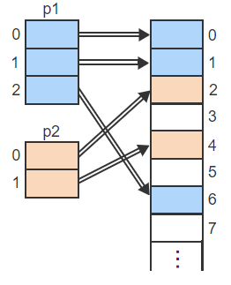
Paging – Visualized – 2
Similarly, process p2's pages are mapped to frames 2 and 4

Slide 41
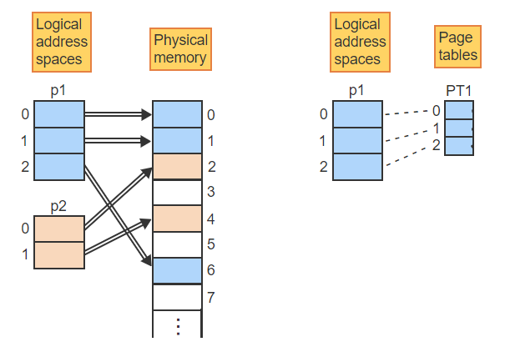
Paging – Visualized – 3
To keep track of the mapping, p1's page table (PT1) has 3 entries, one for each page

Slide 42
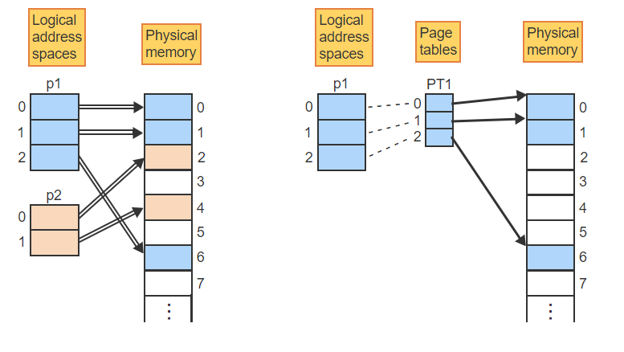
Paging – Visualized – 4
Each page table entry points to the beginning of the corresponding frame

Slide 43
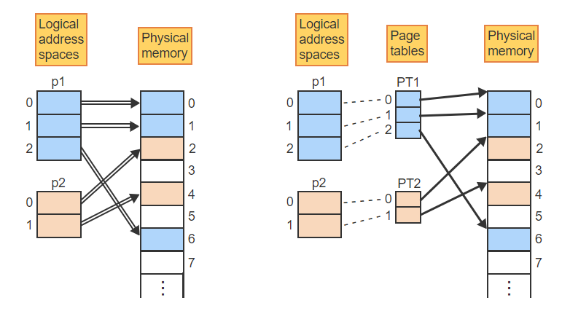
Paging – Visualized – 5
Similarly, p2's page table entries point to the 2 frames holding pages 0 and 1

Slide 44
Logical & Physical Address Size
The size of an address space is of the form 2^{n} , n is the number of bits necessary to form addresses necessary for the entire space.
When the address space is partitioned into pages, the page size 2^{k} , k is the number of bits needed to address every word on a page.
Therefore, the number of pages is 2^{n-k}
The partitioning of the logical address space divides the address into 2 components:
The higher-order n-k bits specify the page number p.
The lower order k bits specify the offset w within the page.

Slide 45
Logical & Physical Address Size
Physical memory is partitioned in an analogous manner.
With m bits in the physical address.
2^m total addresses can be formed.
The frame size must be equal to the page size and thus k bits are needed to address every work within a frame.
The remaining m-k bits determine the number of frames.

Slide 46
Logical & Physical Address Size Examples
An address space with an address size of 16 bits and a page size of 512 words will consist of how many pages?
An address consists of a 5-bit page number and a 4-bit offset.
What is the number of pages?
What is the size of the page?
How can the address (2,3) be denoted in binary?

Slide 47
Address Translation
With paging, a logical address is broken into two components:
A page number p
An offset w within the page.
Similarly, a physical address is broken into two components:
A frame number f
An offset w within the frame.
The notations (p, w) and (f, w) typically denote the concatenation of the two address components.

Slide 48
Address Translation
Ex: If p is 4 bits and w is 5 bits, then (2, 6) denotes the 9-bit address 0010 00110, which is the concatenation of the two components, 2 and 6, in binary.
The OS translates logical addresses of the form (p, w) into corresponding physical addresses (f, w):
Given a logical address (p, w), access the page table entry corresponding to page p.
Read the frame number, f, of the frame containing p.
Combine f with the offset w to find the physical address (f, w) corresponding to the logical address (p, w).

Slide 49
Internal Fragmentation & Bound Check
Paging avoids external fragmentation by having all pages and page frames the same size so that any page fits into any frame without creating holes between frames.
However, the size of a program is generally not an exact multiple of the page size and thus some space remains unused at the end of the last page.

Slide 50
Internal Fragmentation & Bound Check
Internal fragmentation is the loss of usable memory space due to the mismatch between the page size and the size of a program, which creates a hole at the end of the program's last page.
Most programs also do not need all pages of the entire logical address space and must be prevented from accessing any page not belonging to the program.
Some systems implement a valid-bit in each page table entry and prevent access to pages not belonging to the program.
However, the valid bit does not protect the unused fragment on the last partially filled page.
A better approach is to compare every logical address to the program size to prevent access to any memory locations not belonging to the program.

Slide 51
Segmentation & Paging
With paging, all components of a program, including code, static data, the stack, and other data structures, are combined into one contiguous address space divided into fixed-size pages.
Since the components are of variable sizes, the boundaries between the logical components do not coincide with page boundaries.
The misalignment makes the sharing and the protection of logical components difficult.
Segmentation addresses the problem by providing multiple logical address spaces for each process, where each segment can have a different size.

Slide 52
Segmentation
A segment is a variable-size block of a logical address space identified by a single number, the segment number.
With pure segmentation (no paging), a segment occupies a contiguous area of physical memory and is the smallest unit of data for memory management.
A segment table is an array that keeps track of which segment resides in which area of physical memory. Each entry corresponds to one segment and contains the starting address of the segment.

Slide 53
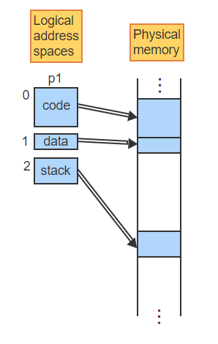
Segmentation – Visualized – 1
Process p1's logical address space consists of 3 segments, which are mapped to variable-size areas in physical memory based on space availability

Slide 54
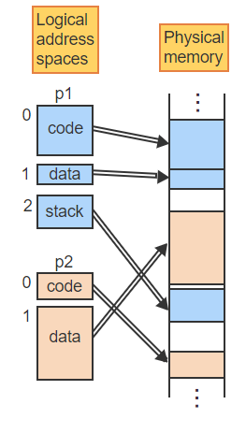
Segmentation – Visualized – 2
Similarly, process p2's segments are mapped to variable-size areas in physical memory

Slide 55
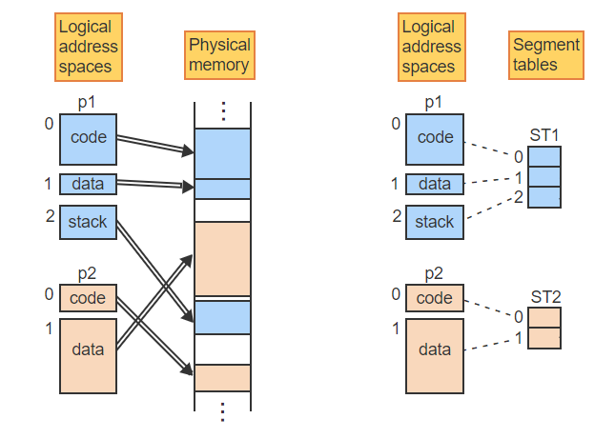
Segmentation – Visualized – 3
To keep track of the mapping, each process has a segment table (ST1 and ST2), where each entry corresponds to one of the segments

Slide 56
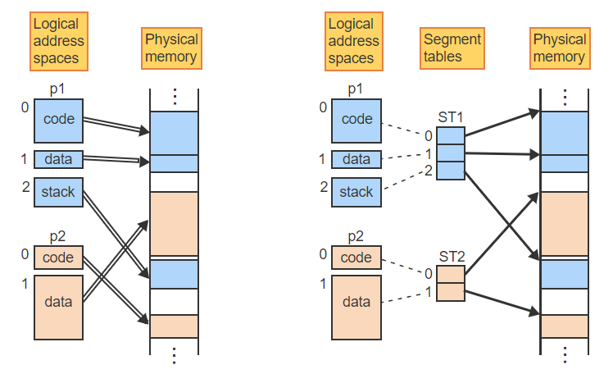
Segmentation – Visualized – 4
Each segment table entry points to the beginning of the corresponding segment in physical memory

Slide 57
Address Translation
Similar to paging, segmentation breaks each logical address into two components:
A segment number s and,
An offset w within the segment.
With an n-bit physical address, 2^n addresses can be formed.
If k bits are used for the offset, the 2^n-k segment numbers can be formed.

Slide 58
Segmentation V.S. Paging
A segment table is analogous to a page table but with two important differences:
With paging, all pages have the same size, 2^k. Since segments have a variable size, 2^k cannot be the actual segment size but only the maximum possible segment size.
To prevent access to locations beyond the segment, the segment size must be kept in the segment table entry and checked when translating the address
With paging, the starting address of a frame can be determined from the frame number f, since all frames have a fixed size and thus all start with the address (f, 0).
With segmentation, no frames exist and thus a segment table entry must contain the complete starting address of the segment, rather than just the segment number s.

Slide 59
Segmentation With Paging
The main advantage of segmentation is the ability to create multiple variable-size address spaces.
The main advantage of paging is the ability to place any page into any frame in memory.
To gain the advantages of both, segmentation can be combined with paging.

Slide 60
Segmentation With Paging
The logical address space consists of multiple variable-size segments but each segment is divided into fixed-size pages.
A logical address is then divided into 3 components:
a segment number s,
a page number p,
and an offset w within the page.
A physical address is divided into 2 components as before:
a frame number f,
an offset w within the frame.
Every process has one segment table where each entry points to a page table corresponding to one of the segments and each page table entry points to a page frame.

Slide 61
Summary
What is the difference between the physical and logical address space?
How does the first fit memory allocation algorithm work?
How does the worst fit memory allocation algorithm work?
What are some advantages/disadvantages of the worst fit memory allocation algorithm?
How does the best fit memory allocation work?
How does the next fit memory allocation algorithm work?

Slide 62
Report Details
The report contains two components:
You must submit a one-page proposal (not graded) by the 19th of March. Once your proposal is approved you can move on to writing your report (or recording your presentation). The proposal can be as short as two paragraphs
You must submit a 1200-word report on an existing operating system. You can include:
An in-depth investigation of algorithms relating to operating systems
A study of how a certain operating system was implemented
Alternatively, you can choose to submit your report in presentation format.
10–12-minute video (minimum-maximum) in presentation format with visualizations to explain certain algorithms.
The presentation video needs to be in tip top shape. Ask yourself the question: if you had a YouTube channel would you post this video?

Slide 63
Report Details – Example
Here is a sample topic:
The Apollo 11 mission had a computer on board named the Apollo Guidance Computer (ACG).
My report/presentation will cover the details of the operation system including:
The scheduling algorithm used.
How memory is allocated.
The history of the operating system and the background details.
The specifications and details of the AGC and how they impacted the operating system.

Slide 64
Report Details – Example Video
https://www.youtube.com/watch?v=UmzsWxPLIOo

